Slide 1
Bank Vault Management System
Course No: CSE 3118 Course Name: Microprocessor & Microcontrollers Lab
Course Teachers
Prof. Dr. Md. Shamim Akhter &
Lomat Haider Chowdhury

Slide 2

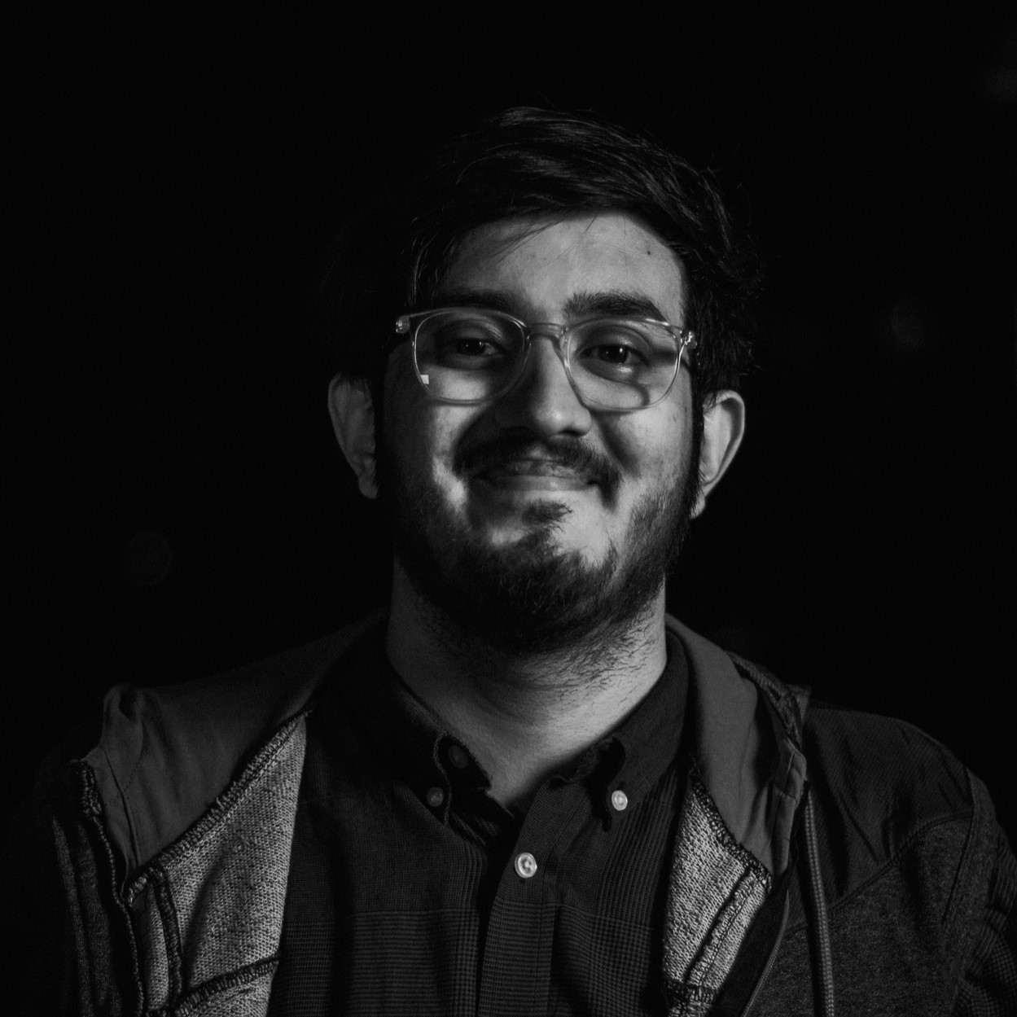
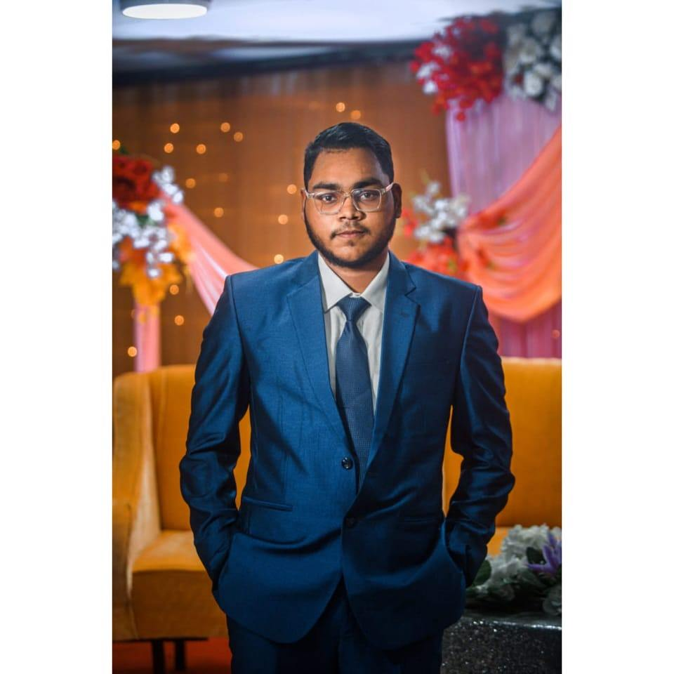
Group: 05 Team Name: Team_Delulu Group Members
Manzar Nur Rahman Eftee Sharjil Shabab Khan Md. Shaleh Abu Mayeen
ID – 20210104105 ID – 20210104108 ID - 20210104123
2

Slide 3
Social Impact:
Impact on Social & Economic Development
Enhanced Security
Crime Deterrent
Trust & Confidence
Employment Opportunities
Customer Convenience
Technological Advancement
Emergency Preparedness
One step closer to being Digital Bangladesh!
3

Slide 4
Economic Development:
Impact on Social & Economic Development
Increased Productivity
Increased Investments
Job Creation
Increased Trust in Banking
Revenue Generation
Infrastructure Development
Tech Sector Growth
Internation Competitiveness
4

Slide 5
Multidisciplinary Contribution:
Bank vault management system involves various stakeholders due to its diverse nature.
• Technical Experts
• Security Professionals
• UX Designer
• Financial Experts
• Maintenance and Support Teams
5

Slide 6
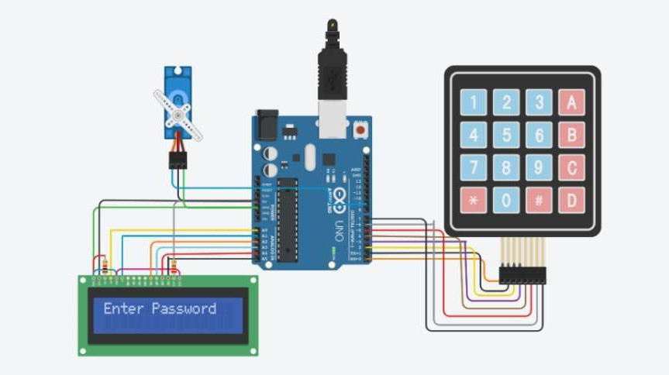
Core Concept
6

Slide 7
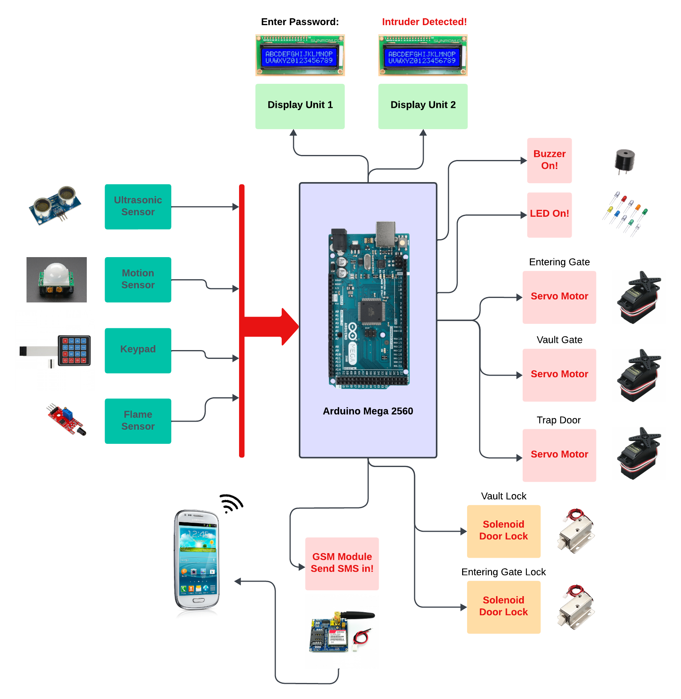
Visualization of our Project
7

Slide 8
Usage of Design tools, hardware and software
Design Tools: Proteus, Photoshop
Hardware: Arduino Mega, Buzzer, Servo Motor, Keypad, LED, register, Ultrasonic Sensor, GSM Module, Display, Lock
Software: Arduino IDE
8

Slide 9
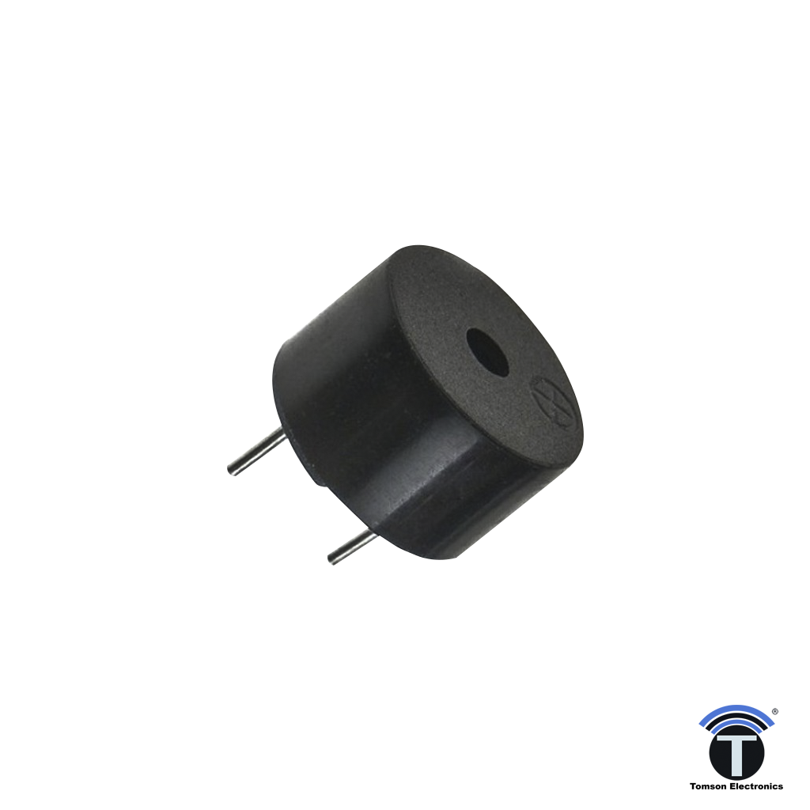
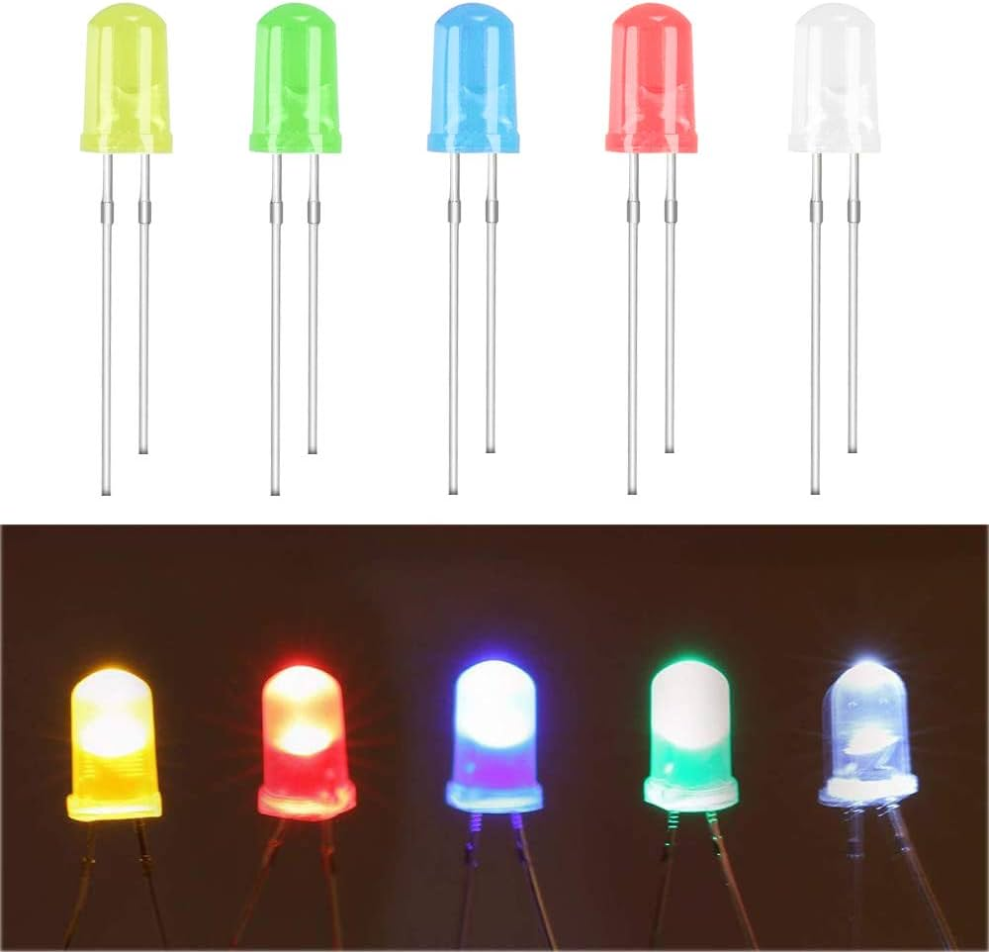
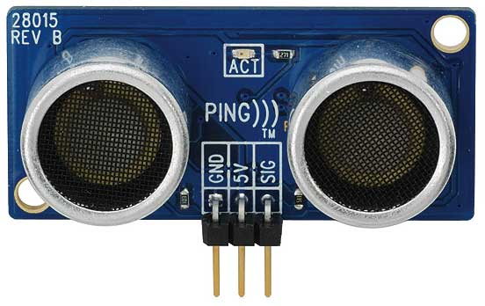
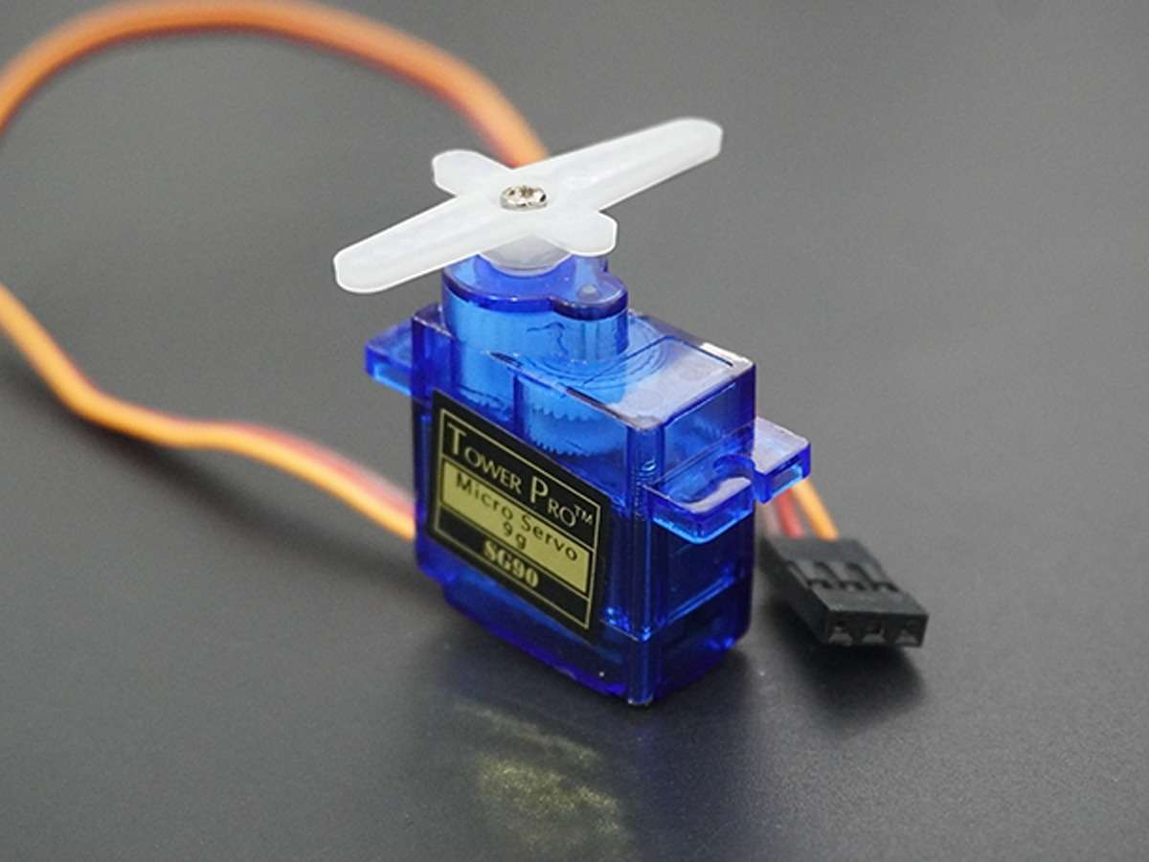
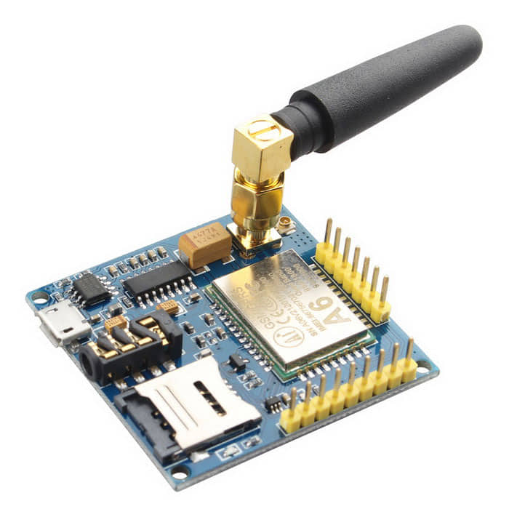
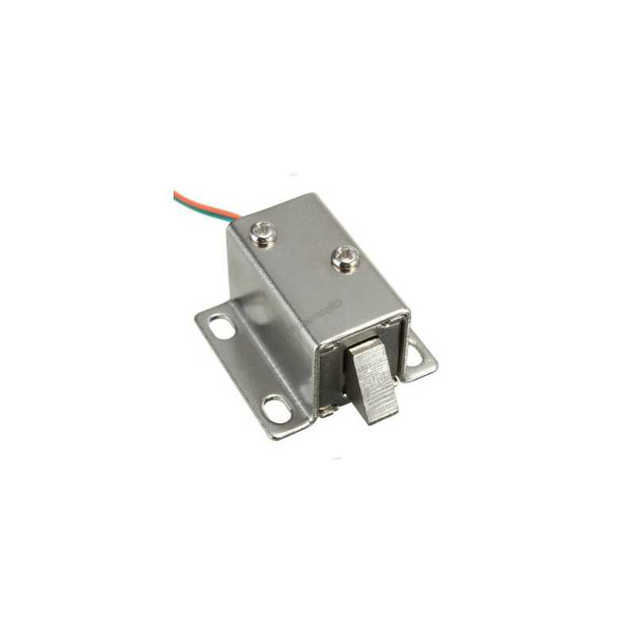
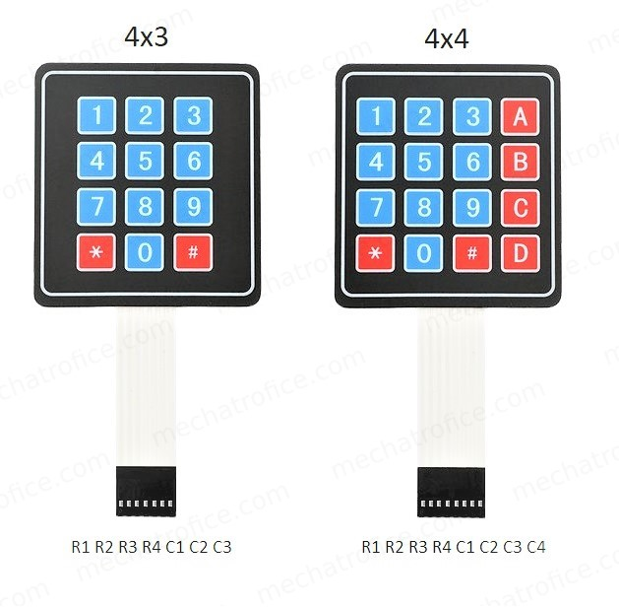
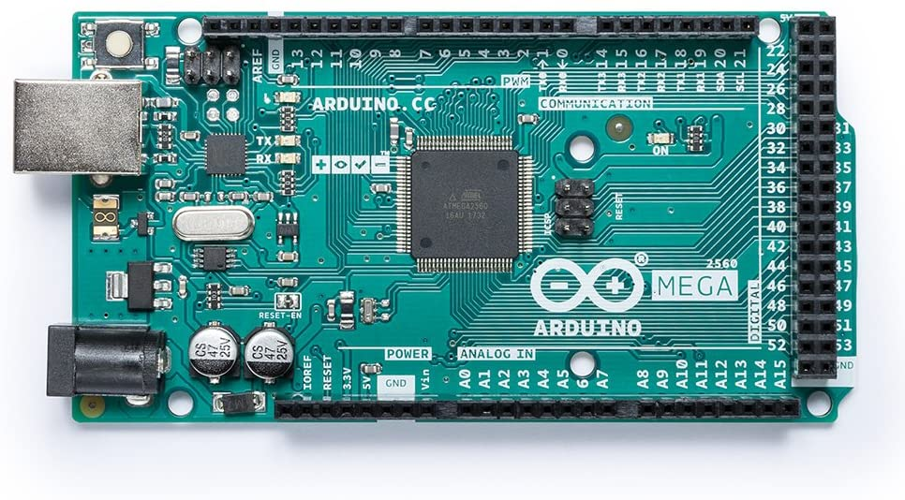
Sensor & Modules
LED
Buzzer
Ultrasonic Sensor
Servo Motor
GSM Module
Solenoid Door Lock
Keypad
Arduino Mega
9

Slide 10
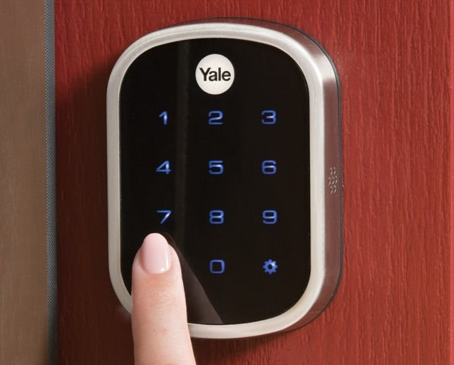
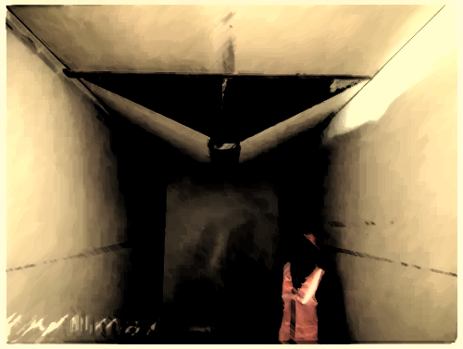

Working System
Keypad Unlocking System
Trap Door
System
Alarm & Messaging
System
10

Slide 11
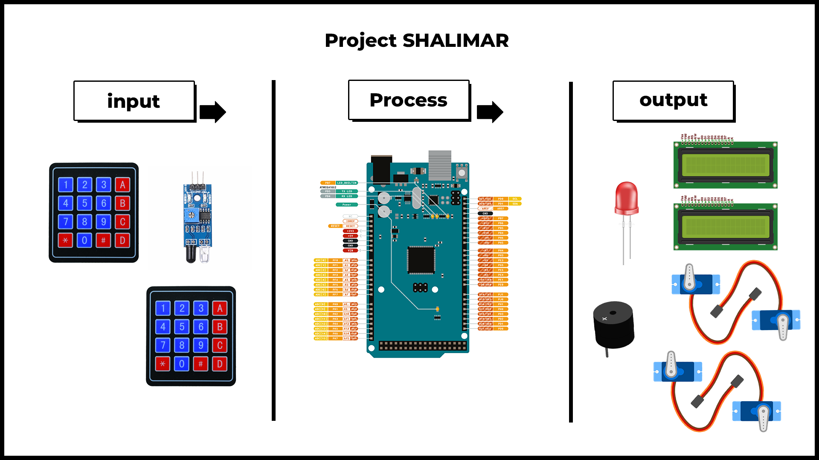
Final Design Sheet
11

Slide 12
Challenges
• Implementing Dual Display
• Using Keypad and resetting the password
• Regarding the doors and locks!
12

Slide 13
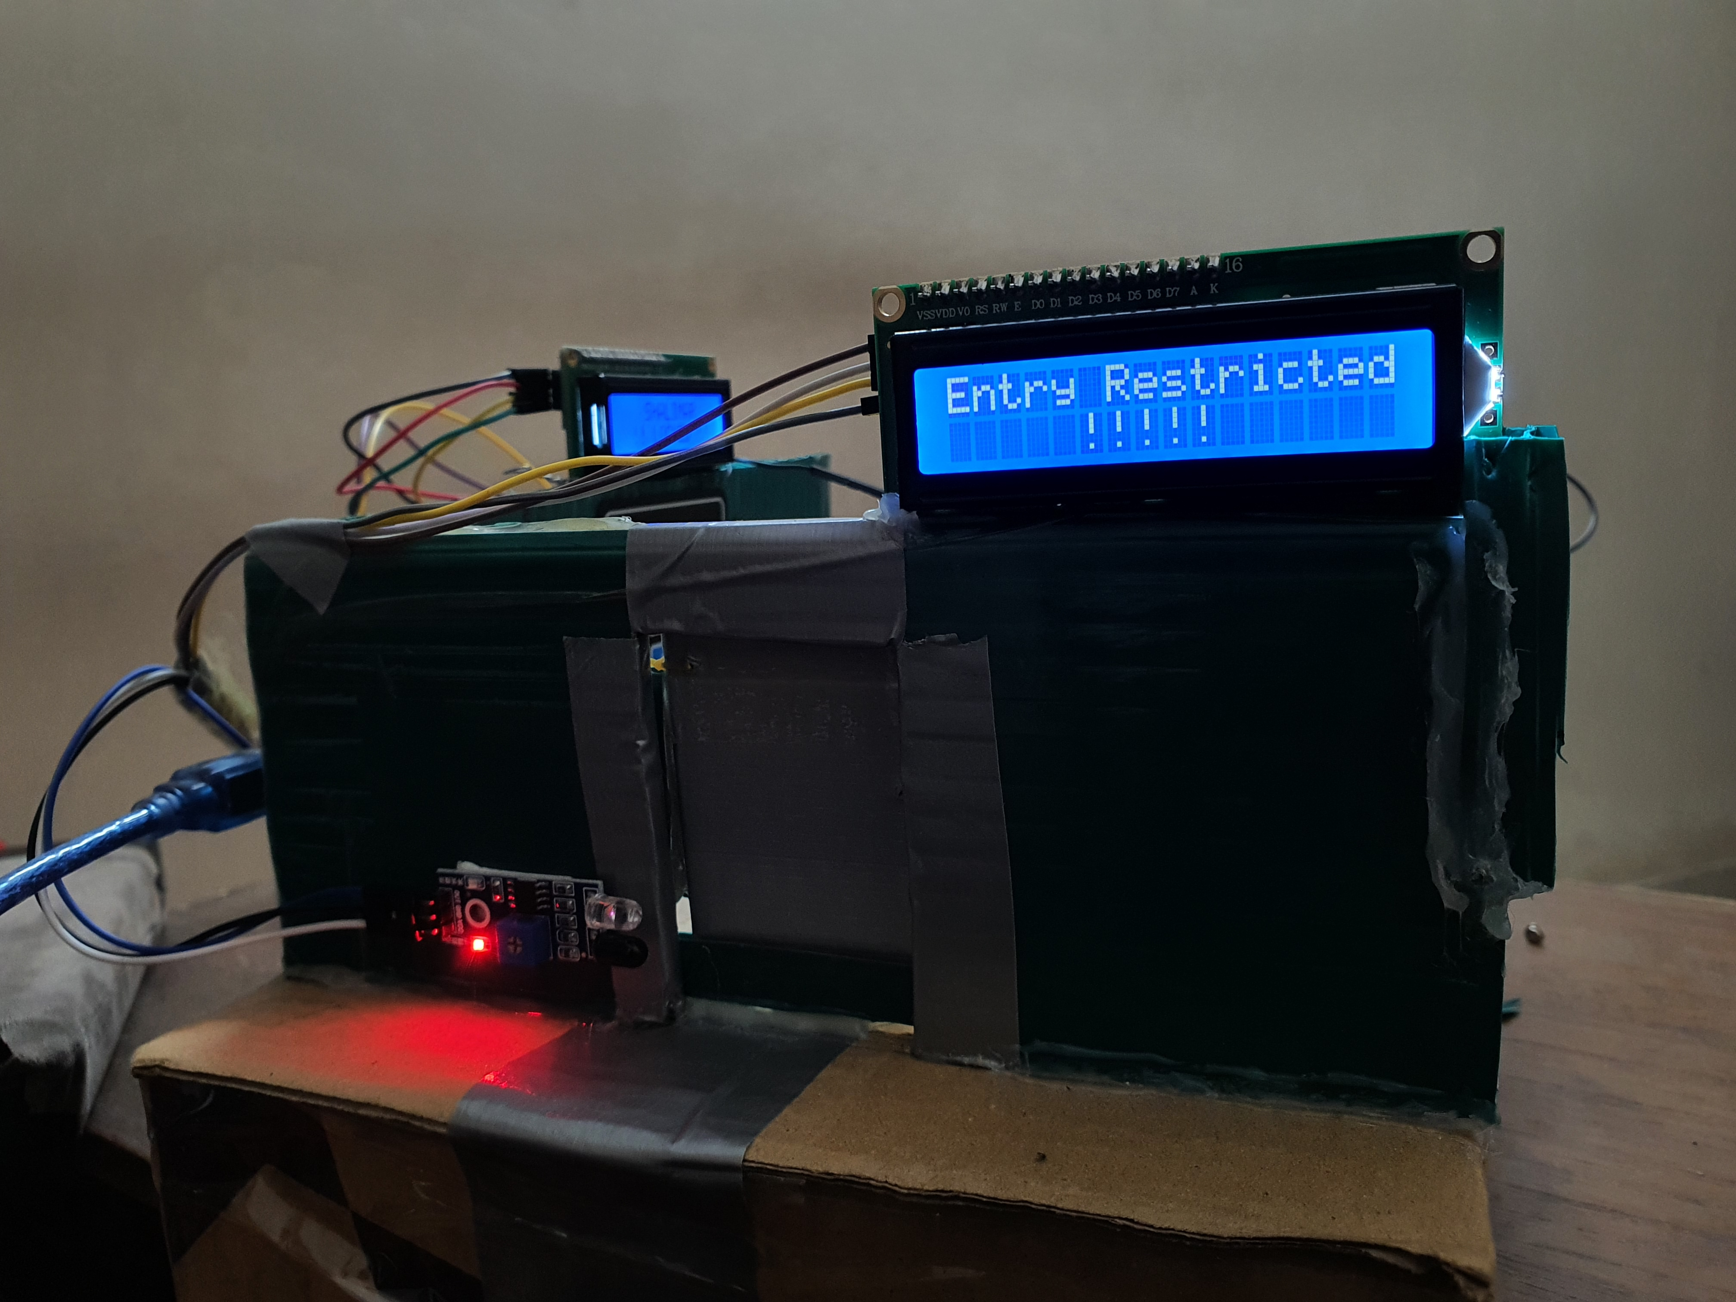
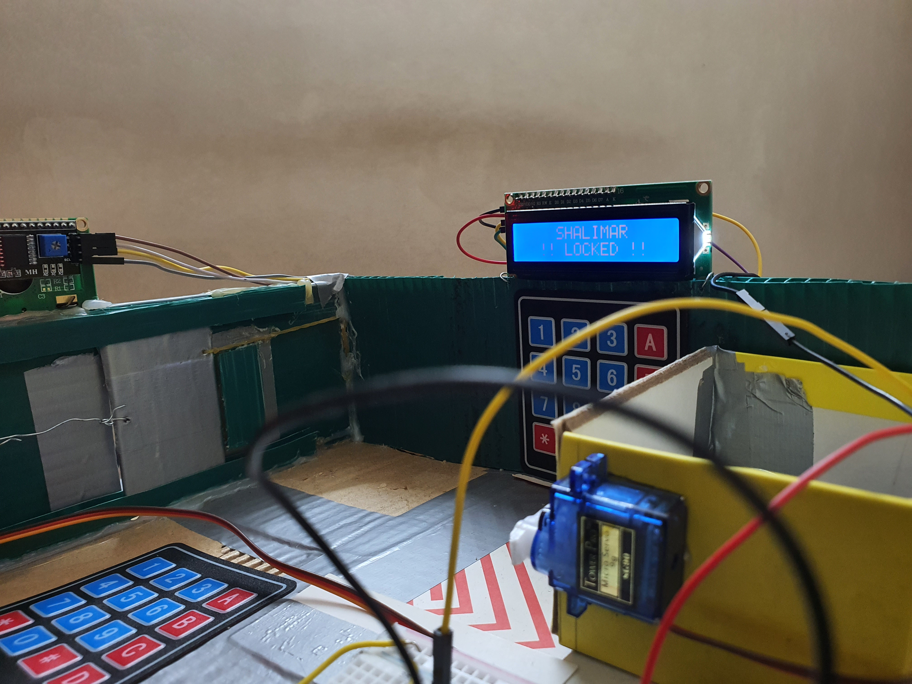
Final Look
13

Slide 14
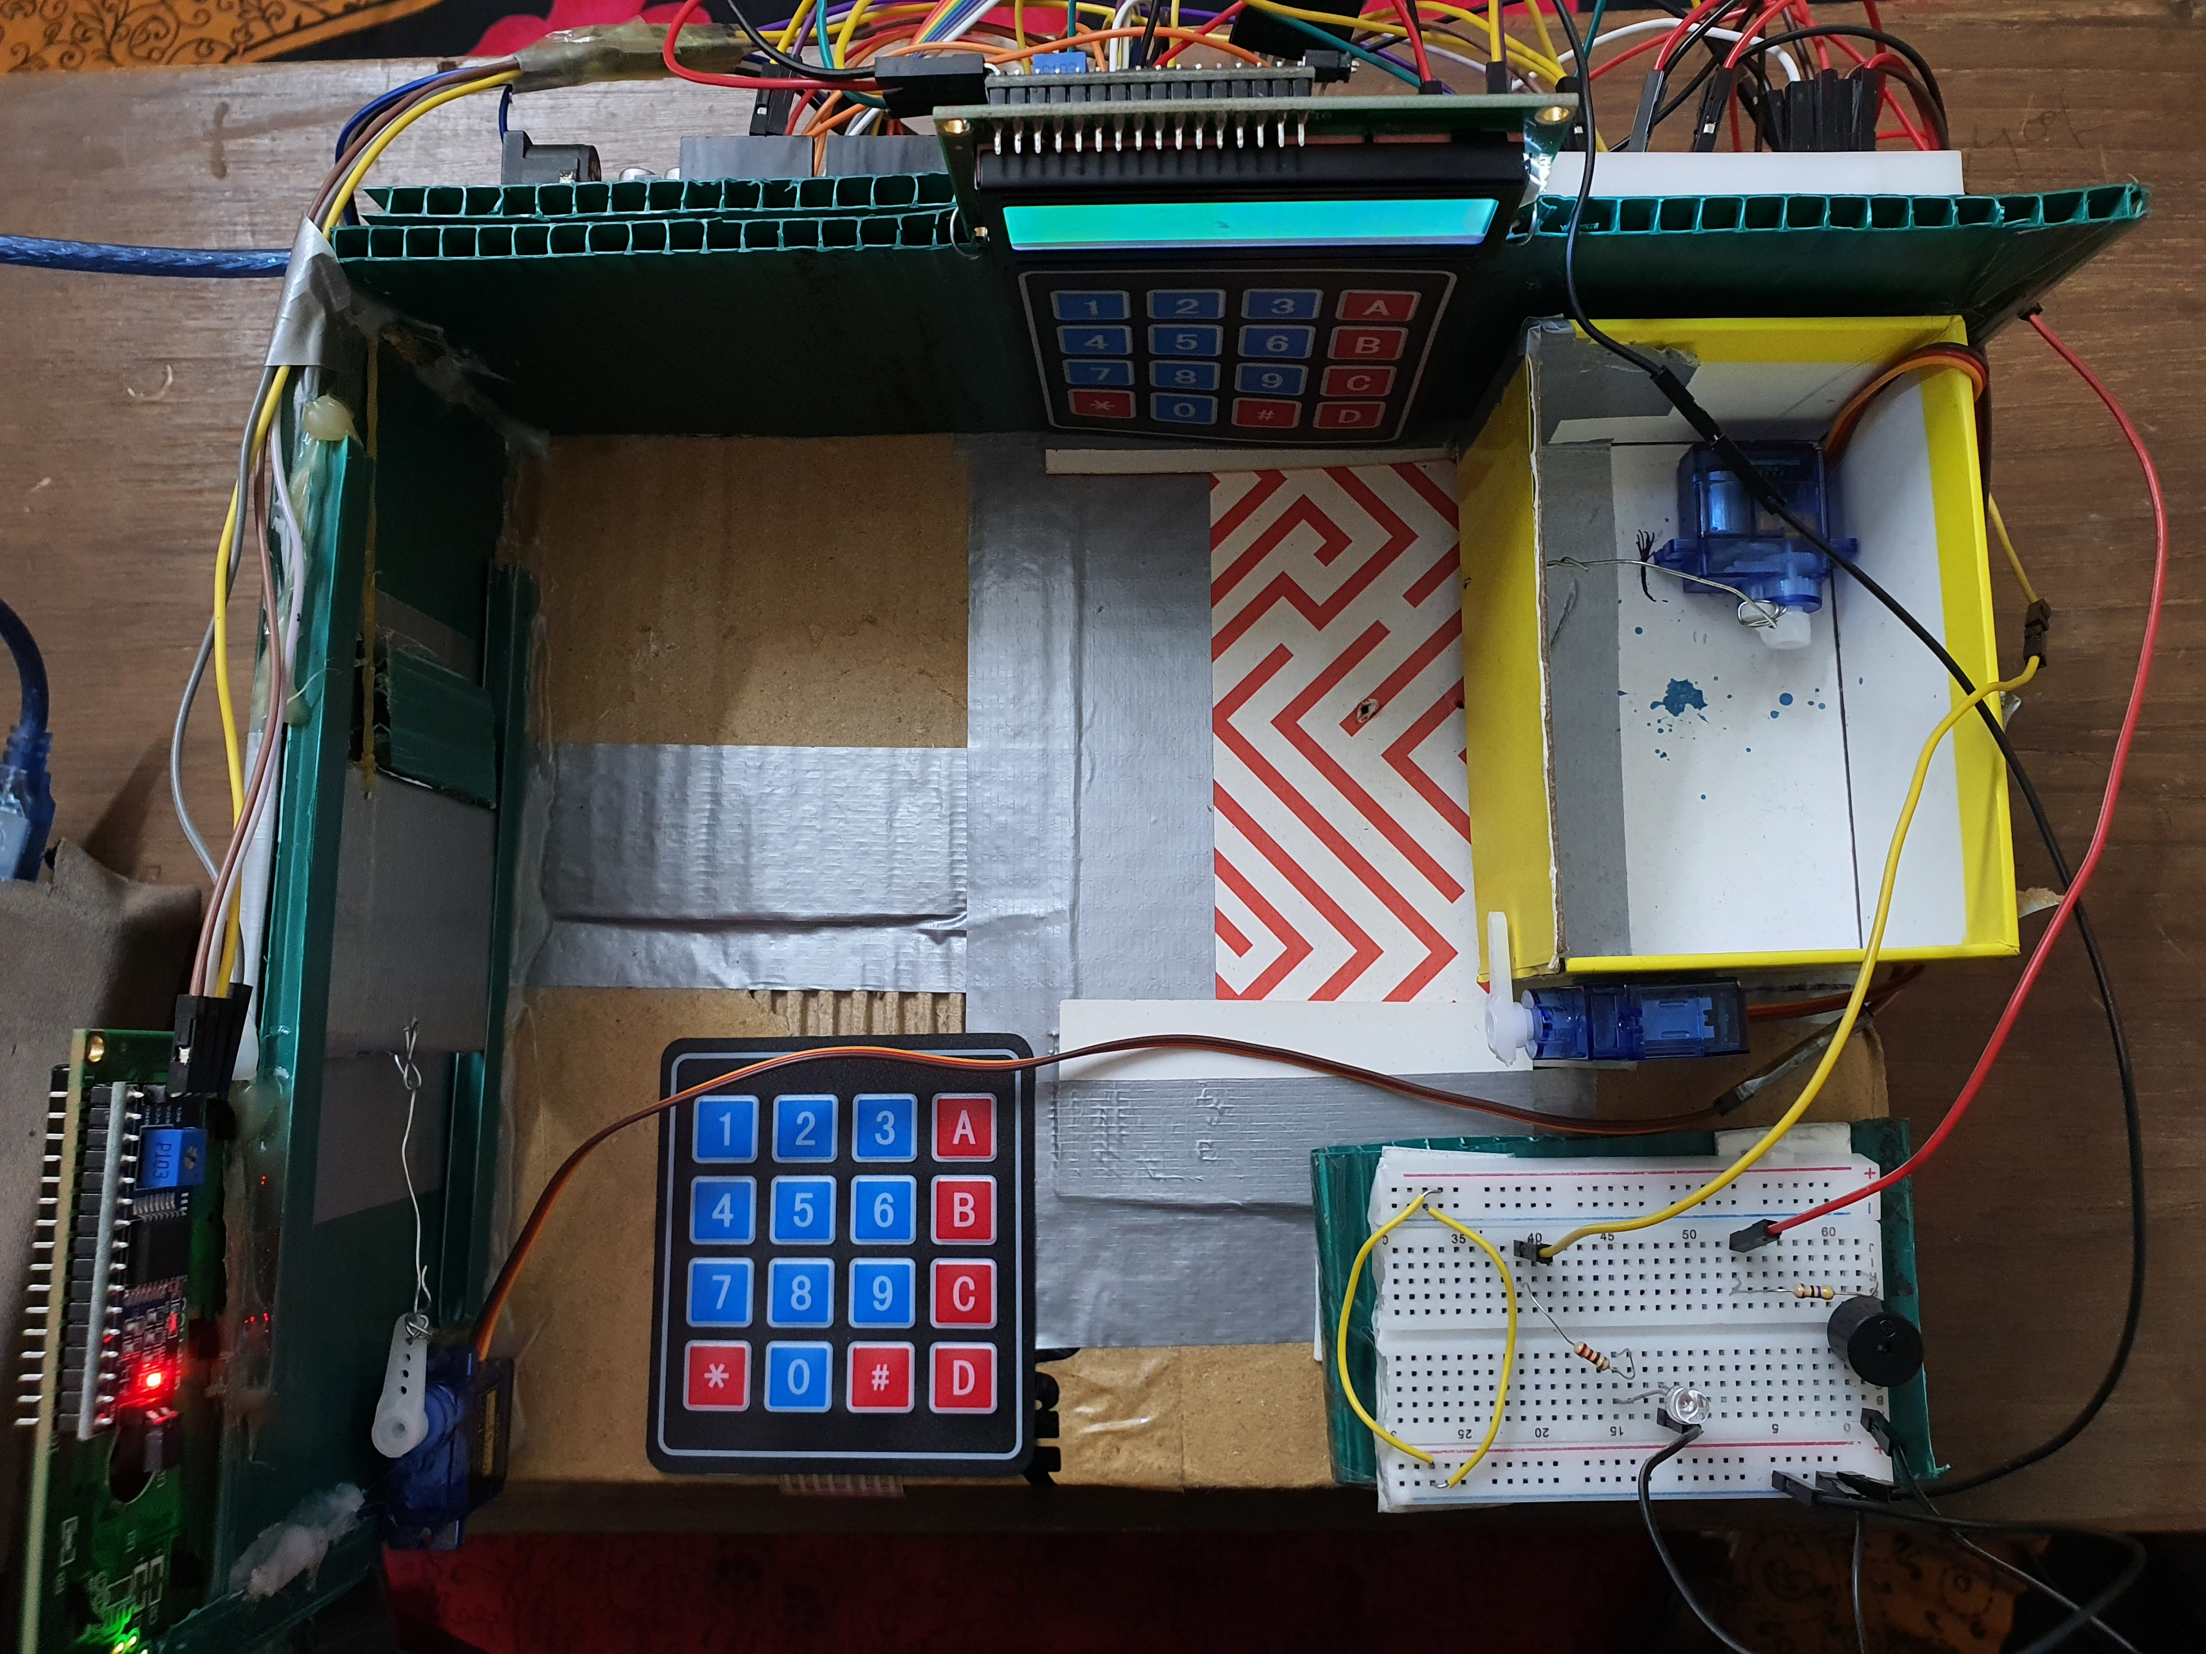
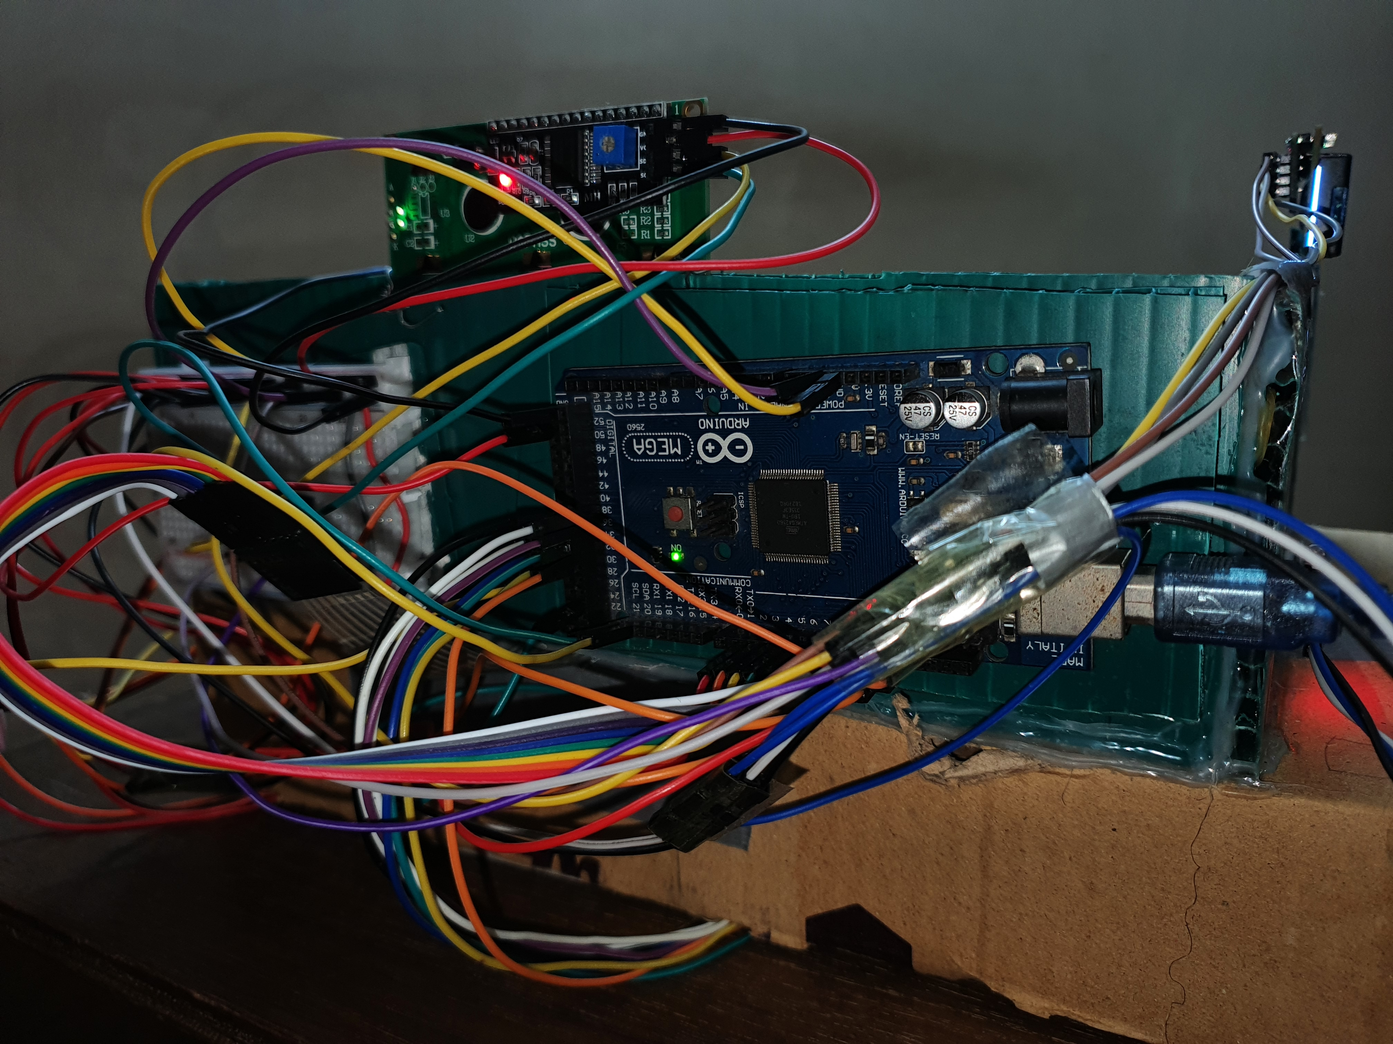
Final Look
14

Slide 15
Limitations
• Couldn’t Implement Camera
• Couldn’t Implement GSM Module
15

Slide 16
Multidisciplinary Approach:
Bank vault management system involves various stakeholders due to its diverse nature.
• Mechanism of Door
• Security Professionals
• UX Designer
• Software Developer
16

Slide 17
Thank you!
Do you have any questions?
17

